Slide 1
Final Presentation
of
DONORS CHOOSE

Slide 2
Group Members
180041208
Fida Kamal
180041214
Fariha Fairoz Nohan
180041229
Alvi Aveen Khan
‹#›/12

Slide 3
Introduction
Donors Choose is a medium between potential donors and charities.
Potential donors will be able to search for charities available in the system.
On the page for a specific charity, they will be able to see a general overview of the charity.
They can make monetary and non-monetary donations based on what specific organizations receive.
Charities will have to contact support staff and verify that they are a legitimate non-profit organization, upon which they will be given an account on the system.
‹#›/12

Slide 4
User Requirements
Must Have
Wish to Have
Profile page for charities
Search for charities based on category
Notifications about future events
‹#›/12

Slide 5
User Requirements
Must Have
Wish to Have
Verification via user reviews
Outcomes of donations
User profiles
‹#›/12

Slide 6
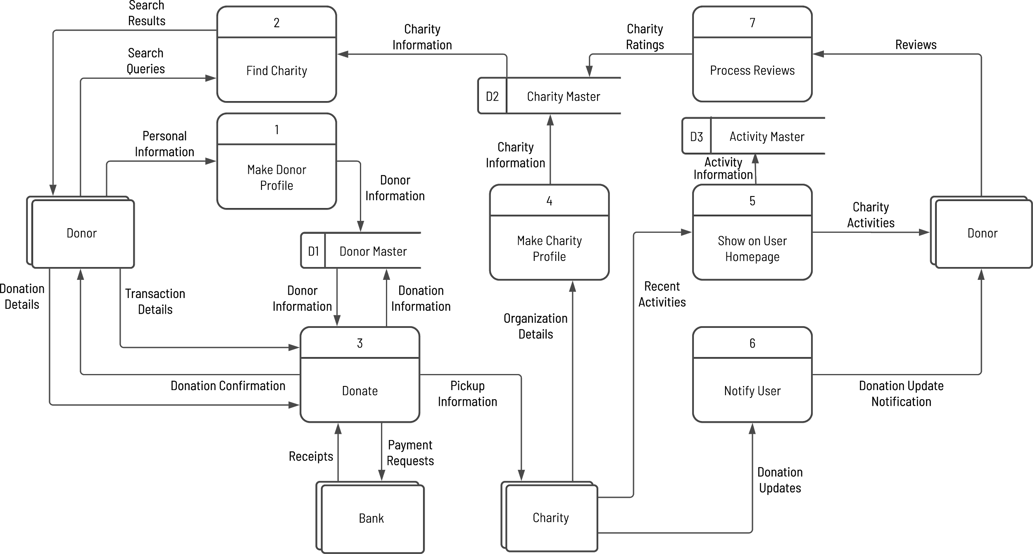
Diagram 0
‹#›/12

Slide 7
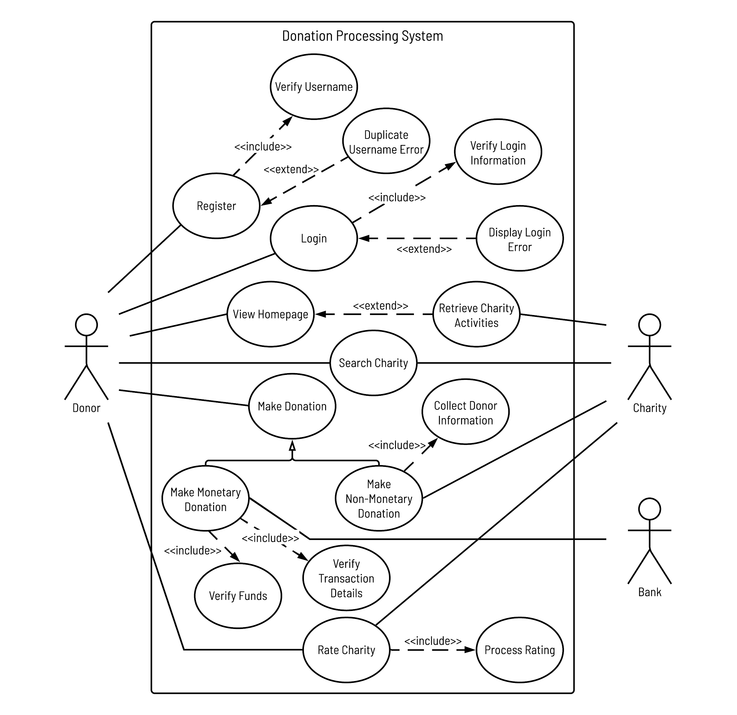
Use Case Diagram
‹#›/12

Slide 8
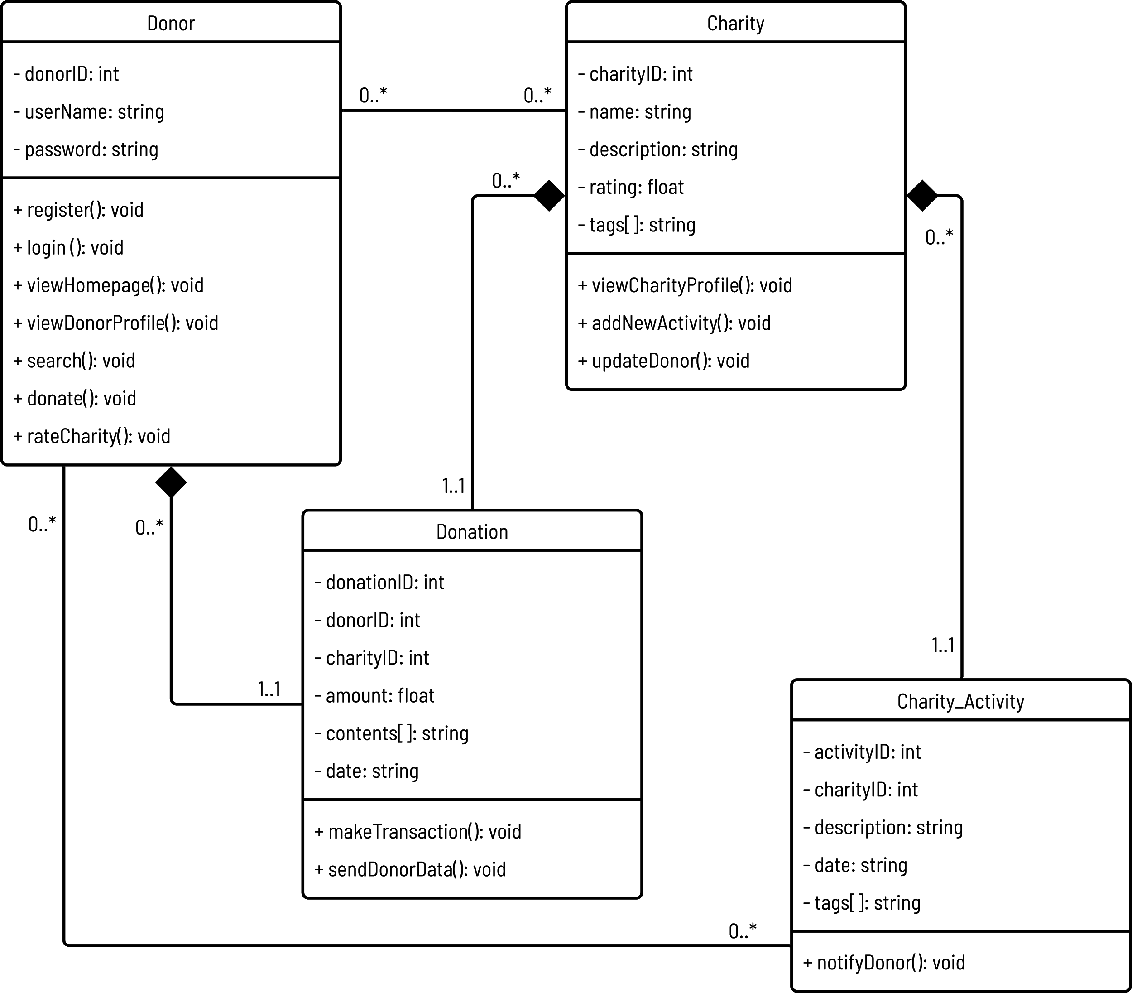
Class Diagram
‹#›/12

Slide 9
System Features
Implemented
Payment gateway for monetary donations
Donation history in donor profile
Login and Registration pages for donors and charities with user authentication
Searching for charities by name and donation categories
Charity profile pages
‹#›/12

Slide 10
System Features
Under Implementation
Not Implemented
Non-monetary donations
Charity activities
User interface improvements
Charity review system
Donation update notifications
‹#›/12

Slide 11

Demonstration

Slide 12
THANK YOU!

